Slide 1
UNIT - I

Slide 2
What is Robotic Process Automation?
In our daily life, there is automation and automation everywhere.
Eg: Washing machines, microwave oven, auto pilot modes, auto taxi,
Nestle using robots to sell…
Walmart testing drones to deliver products
Bank checks being sorted using OCR

Slide 3
Automation – autos (self) + montos (moving)
Coined in 1940 by ford Motor Company
Automation is technology that deals with the application of machines and computers to the production of goods and services.
This helps in getting work done with little or no human assistance
many software systems were developed to accomplish tasks that were previously done on paper to manage businesses, or not being done at all due to the lack of tools.

Slide 4
Automation Vs Software Development
automation and software development are two different terms.
If some portion of a workflow can be programmed to be done without human intervention, it can be called automation
in order to pass any invoice in a payment system, xxxx at ABC organization needs to check that goods have been delivered and recorded in an inventory management system
Solution is to integrate those to systems using database integration techniques.
i.e., a procedure that fetch data from inventory and automate check of receivables
Developing an inventory management software system is called software development, while programming a step so that no more human intervention is required is called automation

Slide 5
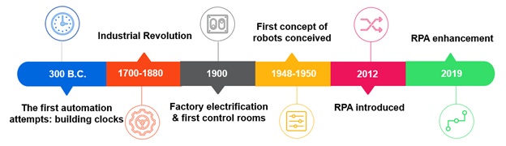

Slide 6
What should be automated?
The following processes should be automated:
Repetitive steps
Time-consuming steps
High-risk tasks
Tasks with a low-quality yield
Tasks involving multiple people and multiple steps
And everything else

Slide 7
What can be automated?(Charateristics)
Well defined and rule-based steps
Logical
An input to the task can be diverted to the software system
Input can be deciphered by software systems with available techniques
The output system is accessible
Benefits are more than the cost

Slide 8
Techniques of automation
Custom software:
Developing new software to perform repetitive tasks.
Runbook:
Runbooks are typically used for IT-based operations.
They are a compilation of a set of commands or tasks that are performed for maintenance and other types of activities.
Runbooks can be offline as well, often referred to as run commands for performing sets of tasks.
Batch:
They used to compile a sequence of commands that could be run by a single click or command.
They can also be scheduled to be run at a specific time using the scheduler.

Slide 9
Wrapper
Wraps around existing software or hosts client applications.
The wrapper monitors activities in a client app and performs actions based on rules.
Browser automation
Greasemonkey and many other web macro software helped in browser-based automation.
It can be used to read from a website and save to a database.
It can also write to fields based on rules.
Using this technique, a whole website can be changed, and components can be added or removed from the website

Slide 10
Desktop automation
Traditionally, desktop automation used to mean that multiple screens on a desktop were woven together to present a single screen, and if there was some data transfer from one screen to another, it could be done automatically.
Recently, assisted Robotics process automation has also been considered for desktop automation by some companies.
Database/web service integration
In database integration, we read/write to a client database directly.
In web service integration, we communicate with the client system using a web service

Slide 11
Robotic process automation
Robot in Robotic process automation means software programs that mimic human actions
RPA involves the use of software that mimics human actions while interacting with applications in a computer and accomplishing rule-based tasks
software Robots also perform complex calculations and decision making on the basis of the data and predefined rules
in the area of artificial intelligence, it has become possible to use State activity: Transitions contain three sectionsdTrigger, Condition, and Action
Technologies adopted with RPA
ML, NLP, Computer Vision, Natural language generation

Slide 12
With RPA, it has become much easier to automate tasks.
Now, we need to know only the steps taken by humans and make the Robots mimic the action on a computer screen using mouse and keyboard.
Business logic, validation of data, transformation, and use of data is already coded in existing systems that humans use to accomplish a task, a simple example being invoice data entry.
RPA platforms allow the program, called Robots,
to interact with any application in the same way a human would do,
hence, automating rule-based work by recording those steps for later playback.

Slide 13
point that distinguishes RPA from traditional automation is that the software Robot is trained using steps that are illustrative rather than using instructions based on code
RPA is capable of adapting to dynamic circumstances
From tedious, repetitive, and high volume tasks, to diverse, complicated systems that need to work together lucidly, RPA can handle it all.
There is consistency in quality, accuracy, productivity and efficiency, faster delivery of services, and of course, lower operation costs.

Slide 14
Benefits of RPA
Business process outsourcing (BPO):
With RPA and its benefits of reduced costs, the BPO sector can now depend less on outsourced labor

Slide 15
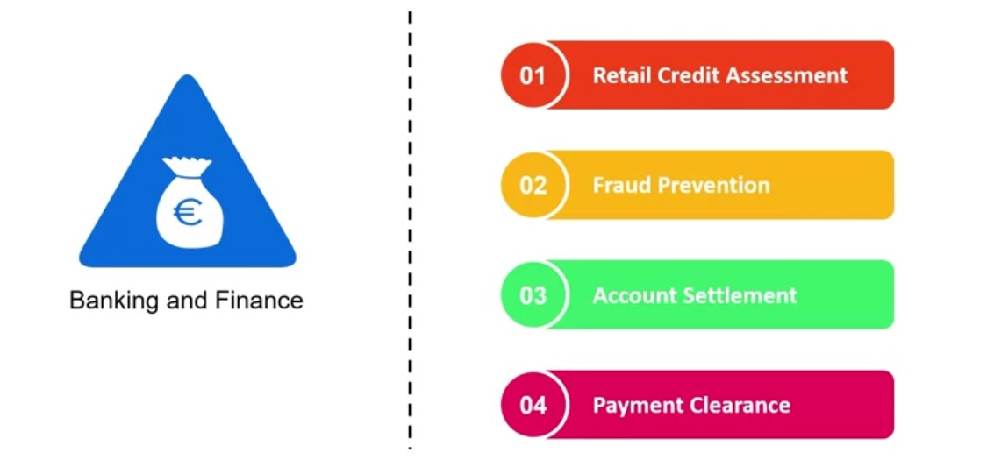

Slide 16
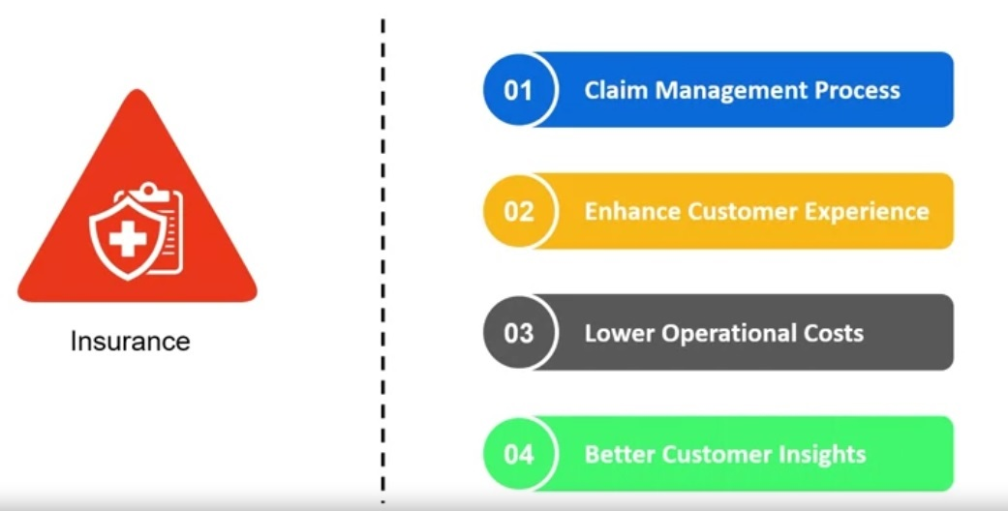

Slide 17
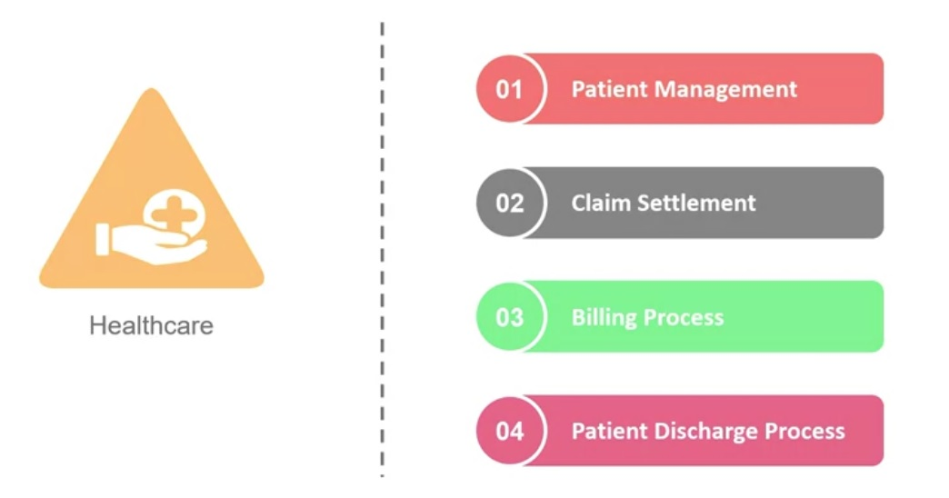

Slide 18
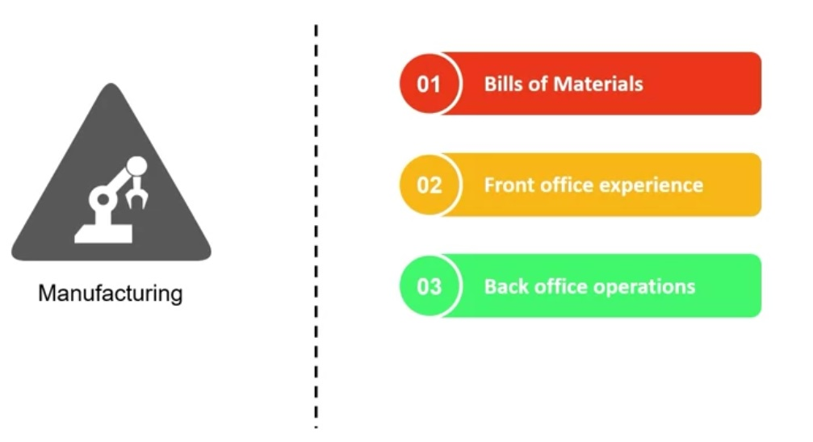

Slide 19
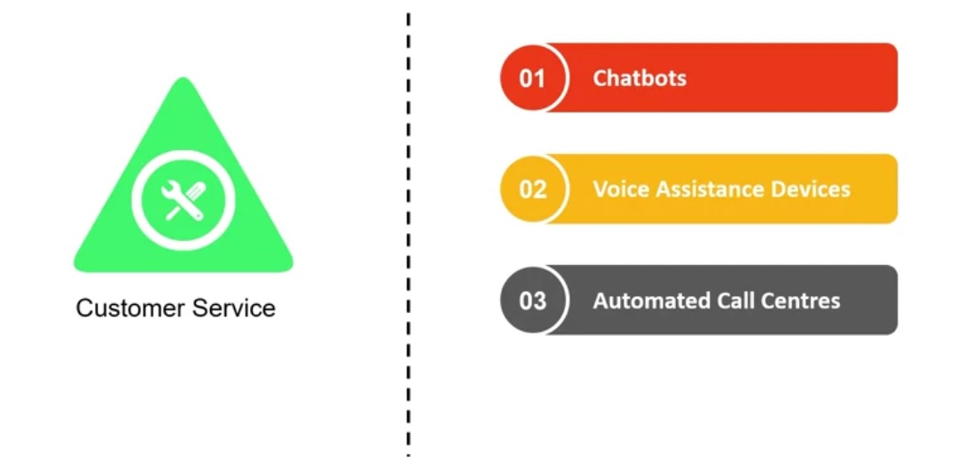

Slide 20
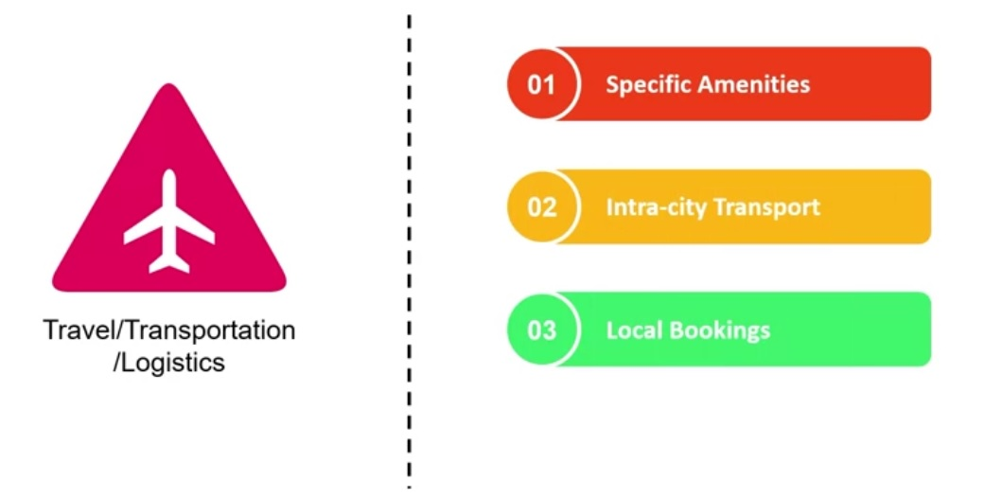

Slide 21
Benefits of RPA
Higher quality services, greater accuracy
Improved analytics
Reduced costs
Increased speed
Greater Compliance
Agility
Comprehensive insights
Versatility (from small to large businesses, simple to complex processes)
Simplicity
Scalability
Time Saving
Non invasive
Better Management
Better Customer Service
Increased employee satisfaction

Slide 22
Improved analytics
Since these software Robots can log each action taken with the appropriate tag and metadata
it is very easy to get business insights and other analytical data
Greater compliance
a full audit trail is one of the highlights of RPA and can result in greater compliance.
These Robots do not deviate from the defined set of steps to be taken while doing a task
Agility
Reducing and increasing the number of Robot resources requires managing the volume of the business process.
More Robots can be deployed to perform the same task easily.
Redeployment of resources does not require any kind of coding or reconfiguration

Slide 23
Comprehensive insights
Robots can tag transactions to use them later, in reports for business insight.
By using these business insights, better decisions can be made for the improvement of the business.
Non- invasive
RPA, as we know, works at the user interface just like a human would.
This ensures that it can be implemented without bringing changes to the existing computer systems.
This helps in reducing risks and complexities

Slide 24
What RPA can Do?
Beyond repetitive tasks
ability to create full audit trails
improved the quality of work
eliminate human error
Once trained, attains same precision over and over again.
can interact with applications irrespective of the technologies on which the applications are built.
They can work with popular ERP applications such as SAP, Oracle, or Microsoft Dynamics, and BPMs such as Pega systems and Appian
Custom applications built on .NET, Java, the command-line, or mainframe terminal are easy
inclusion of AI technologies, RPA now has the capability to read from images or scanned documents, and it can interpret unstructured data and formats as wel

Slide 25
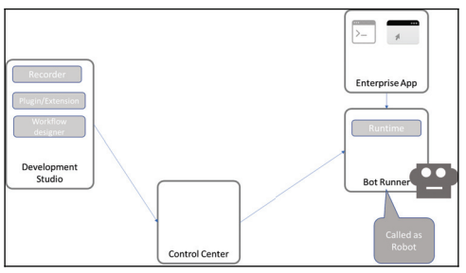
Components of RPA

Slide 26
Components I
Recorder
part of the development studio that developers use to configure the Robots.
It is like the recorder in any Automated tools, the bot recorder in any platform, records steps.
It records mouse and keyboard movements on the UI and this recording can be replayed to do the same steps again and again.
This enables rapid automation
Bot runner
This is also referred to as the Robot, other components make it run.

Slide 27
Components II
Development studio
used by developers to create Robot configuration or train the Robots.
a set of instructions and decision-making logic is coded for Robots to execute.
Some platforms
provide flow-charting capabilities such as Visio, so it becomes very easy to plot steps in a process,
whereas some other platforms require coding.
For commercial development, developers need knowledge of programming
for example, loops, if else, variable assignment, and so on

Slide 28
Components III
Extensions and plugins
To ease the development and running of bots.
In many applications, such as Java SAP, it is not easy to individually identify controls of the UI through traditional techniques.
RPA vendors have developed plugins and extensions to help with these issues
Control center
to provide Robot management capabilities.
It monitors and controls a Robot's operation in a network.
to start/stop Robots,
make schedules for them,
maintain and publish code,
redeploy Robots to different tasks, and
manage licenses and credentials

Slide 29
RPA platforms
Automation Anywhere
UiPath
Blue Prism
WorkFusion
Thoughtonomy
KOFAX

Slide 30
Automation Anywhere
helps to automate business processes for companies.
They focus on RPA, cognitive data (machine learning and natural language processing), and business analytics.
Their bots are capable of handling both structured as well as unstructured data.
System Components
A development client for the creation of a bot
A runtime environment for the deployment of a bot
A centralized command system for handling multiple bots, analyzing their performance:

Slide 31
Automation Anywhere II
HQ: San Jose, California,
USA Est: 2003
CEO: Mihir Shukla
Some key clients: Deloitte, Accenture, AT&T, GM, J P Morgan
Source of revenue by region: Its highest source of revenue is the USA, which accounts for more than half its revenue, followed by APAC, then UK and continental Europe
Source of revenue by industry: The Banking, Financial services, and Insurance (BFSI), healthcare, telecom, media, and other

Slide 32
UiPath
designs and delivers software that helps automate businesses
System Components:
UiPath Studio to design the processes
UiPath Robot to automate tasks designed in UiPath Studio
UiPath Orchestrator to run and manage the processes

Slide 33
HQ: Bucharest, Romania
CEO: Daniel Dines
Key Clients: Atos, AXA, BBC, Capgemini, CenturyLink, Cognizant, Middlesea, OpusCapita, and SAP
Source of revenue by region: North America, Continental Europe, the UK, and APAC
Source of revenue by industry: BFSI, healthcare, telecom and media, and retail

Slide 34
Blue Prism
provide automation that enterprises can use according to their needs.
Blue Prism aims to do this by providing automation that is scalable, configurable, and centrally managed.
It sells its software through its partners, some of which are Accenture, Capgemini, Deloitte, Digital Workforce Nordic, HPE, HCL, IBM, TCS, Tech Mahindra, Thoughtonomy, and Wipro

Slide 35
HQ: United Kingdom
Est: 2001
CEO: Alastair Bathgate
Key Clients: BNY Mellon, RWE npower, and Telefonica O2
Source of revenue by region: More than half of its revenue source comes from the UK, followed by North America, Continental Europe, and APAC
Source of revenue by industry: BFSI, health, and pharmaceuticals, retail and consumer, telecom and media, manufacturing, public sector, travel, and transportation

Slide 36
WorkFusion
based on RPA and machine learning.
It delivers software for automating high volume data.
enables man and machine to work in tandem while managing, optimizing, or automating tasks.
HQ: New York,
USA Est: 2011 CEO: Max Yangkelivich, Andrew Volkov
Key Clients: Thomson Reuters, Infogroup, Citi, and Standard Bank
Source of revenue by region: North America provides more than 80% of WorkFusion's revenue, followed by Europe, APAC, and MEA
Source of revenue by industry: Around 90% of its revenue comes from the BFSI sector, followed by the retail and consumer sectors

Slide 37
Thoughtonomy
delivers software that helps automate business and IT processes.
It uses Blue Prism and other automation software and customizes it:
HQ: London, UK Est: 2013 CEO: Terry Walby
Key Clients: Atos, Fujitsu, CGI, Unite BT, and Business Systems
Sources of Revenue by region: Around 70% of revenue comes solely from the UK. The rest comes from Continental Europe, North America, APAC, and the Middle East and Africa (MEA)
Sources of Revenue by industry: A major part of its revenue comes from third party clients, followed by BFSI, public sector, telecom, healthcare, retail, and consumer sectors

Slide 38
KOFAX
capable of automating and delivering processes that are repetitive and rule-based.
It uses Robots for extracting and consolidating information.
The software platform consists of a management console to deploy and manage bots, Robot performance, and a monitoring system.
This software can also group together high priority tasks that should be completed first by the Robot during times of high workload.
Kofax's software, however, doesn't have machine learning:

Slide 39
HQ: Irvine, California
CEO: Paul Rooke
Key Clients: Arrow Electronics, Delta Dental of Colorado, Pitt Ohio, Audi
Sources of revenue by region: North America accounts for almost half of its revenue, followed by Continental Europe, APAC, and LATAM (Latin America)
Sources of revenue by industry: BFSI, retail, consumer, travel, transportation, public sector, manufacturing, and healthcare

Slide 40
UiPath Studio
helps users with no coding skills to design Robotic processes in a visual interface.
It is a flowchart-based modeling tool. Thus, automation is faster and more convenient.
Multiple people can contribute to the same workflow.
The presence of a visual signal that points out errors in the model, and
a recorder that performs what the user executes, make modeling much easier.

Slide 41
UiPath Robot
UiPath Robot runs the processes designed in UiPath Studio.
It works in both attended (working only on human trigger) and unattended environments (self-trigger and work on their own).
UiPath Orchestrator
UiPath Orchestrator is a web-based platform that runs and manages Robots.
It is capable of deploying multiple Robots, and monitoring and inspecting their activities

